Slide 1
3D Faces Pilot Data
Marisa’s Pilots (n = 2)

Slide 2
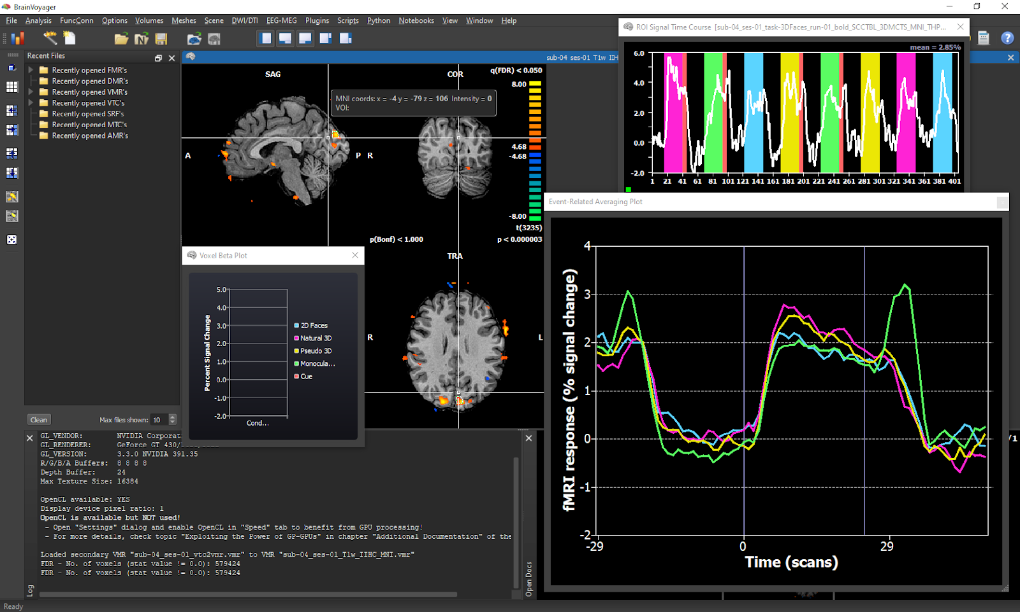
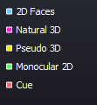
ERA showing potential cue artifact - Sub 4
Pseuodo
Natural 3D

Slide 3
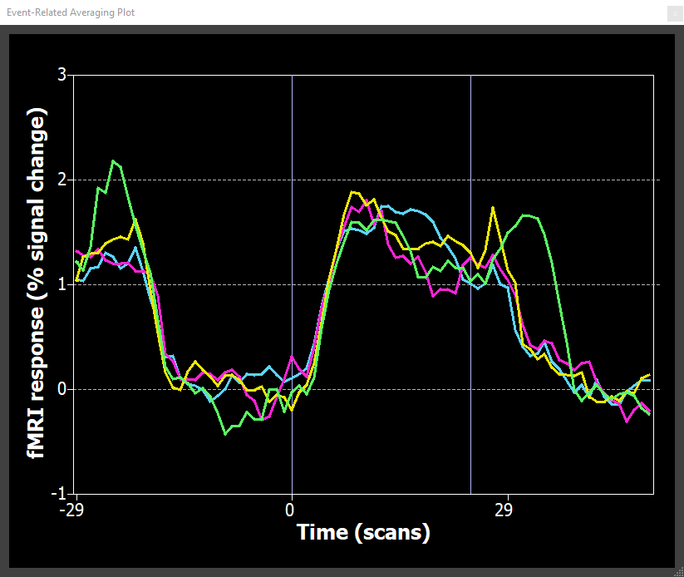
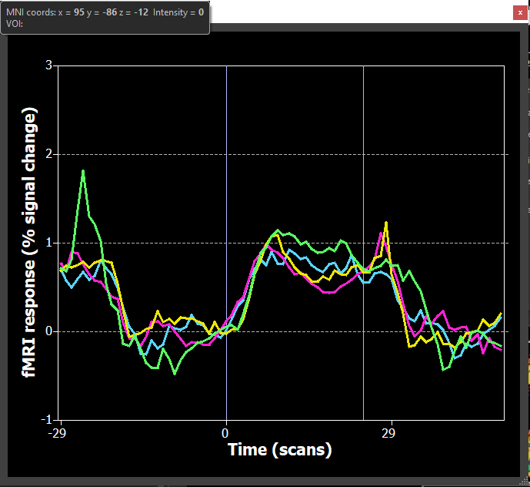
Single Sub All Runs ROI ERAs – V1
Sub 3
Sub 4

Slide 4
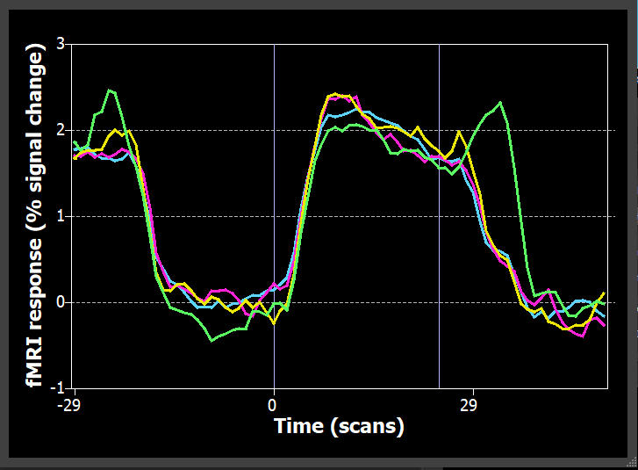
ROI ERAs – V1 (n = 2)

Slide 5
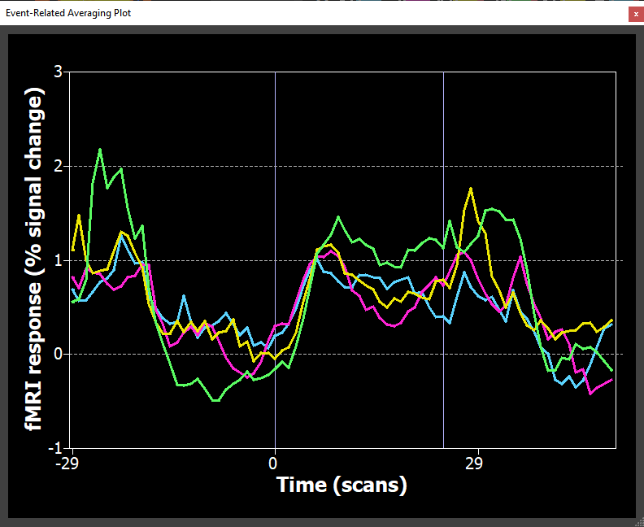
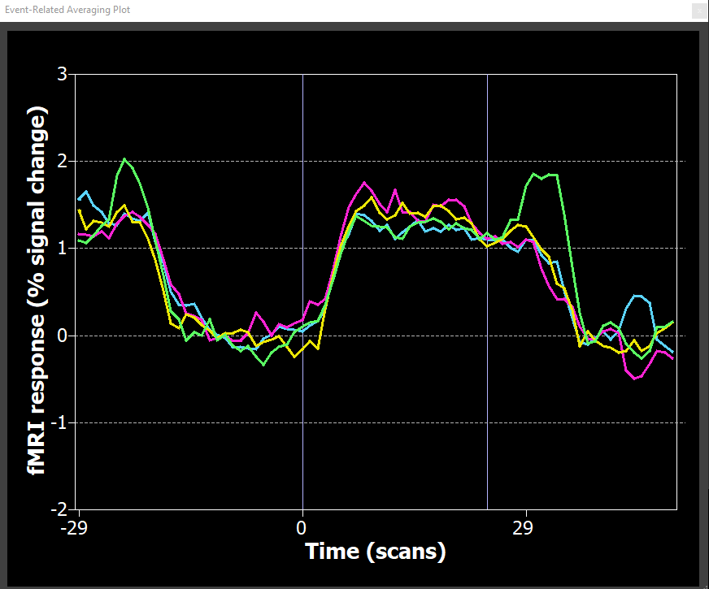
Single Sub All Runs ROI ERAs – V3a
Sub 3
Sub 4

Slide 6
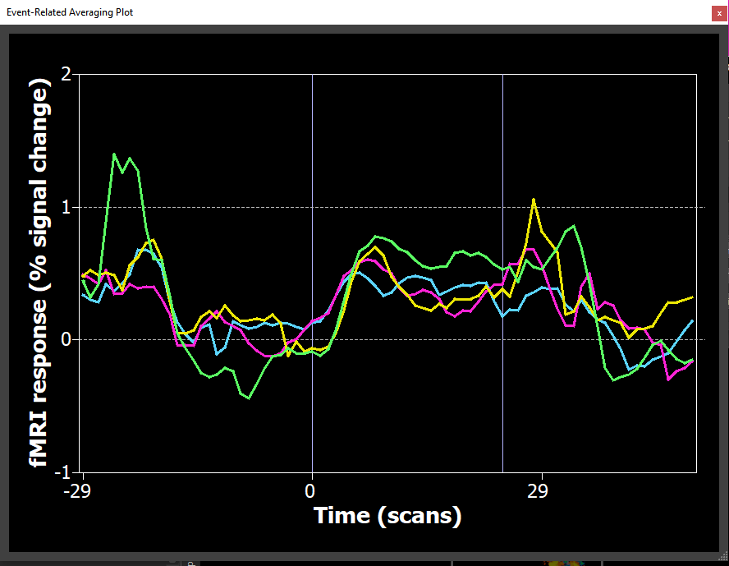
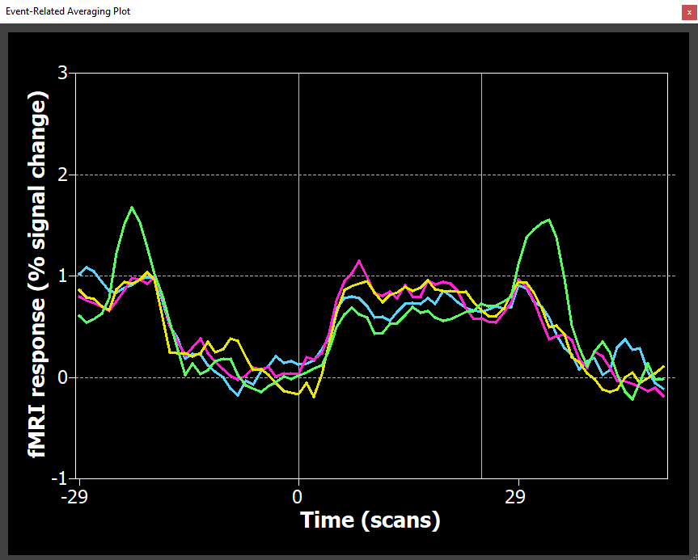
Single Sub All Runs ROI ERAs – V3b
Sub 3
Sub 4

Slide 7
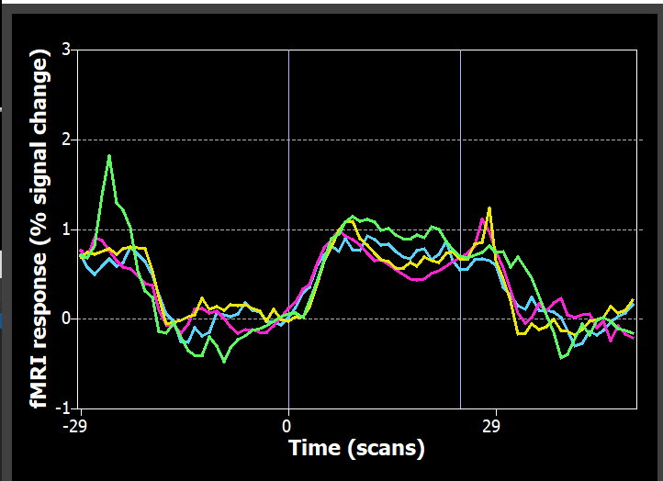
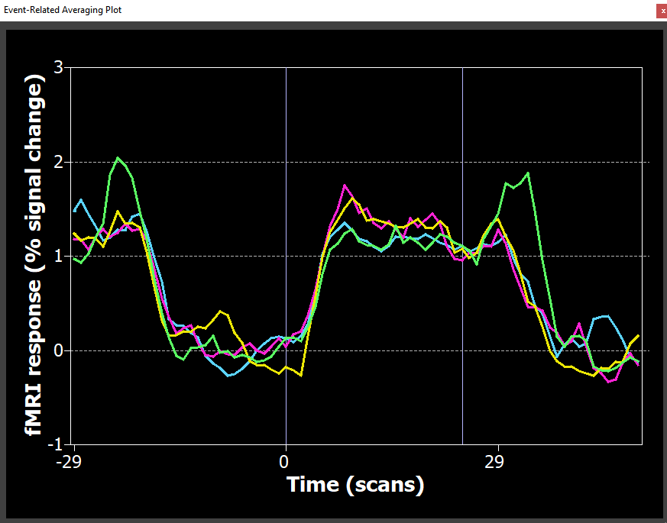
Single Sub All Runs ROI ERAs – LO1
Sub 3
Sub 4

Slide 8
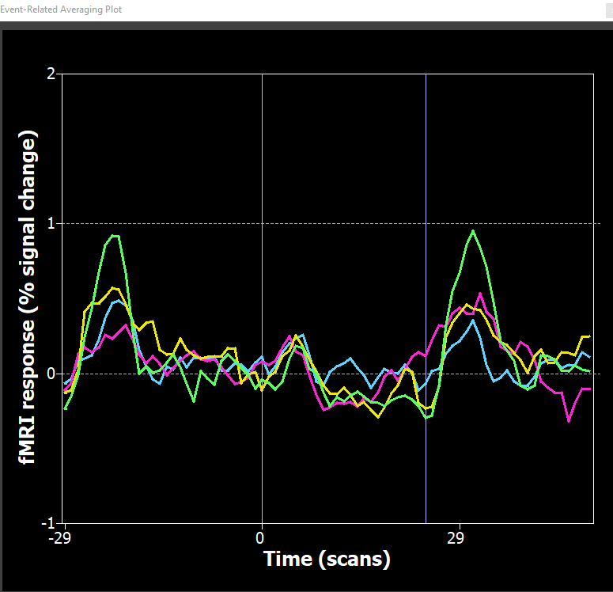
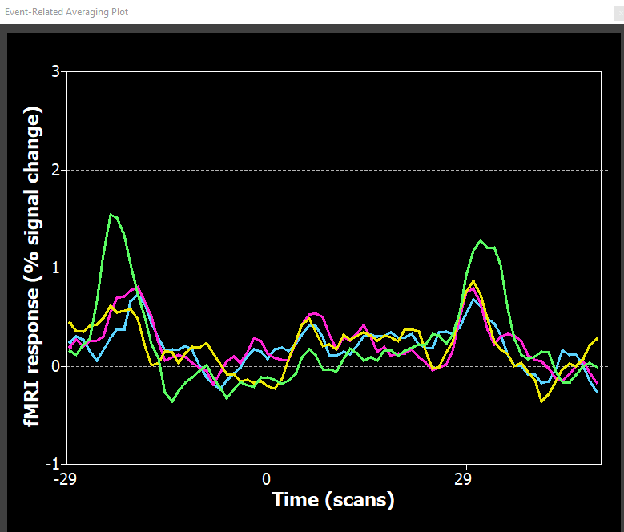
Single Sub All Runs ROI ERAs – MT (Rosenke)
Sub 3
Sub 4

Slide 9
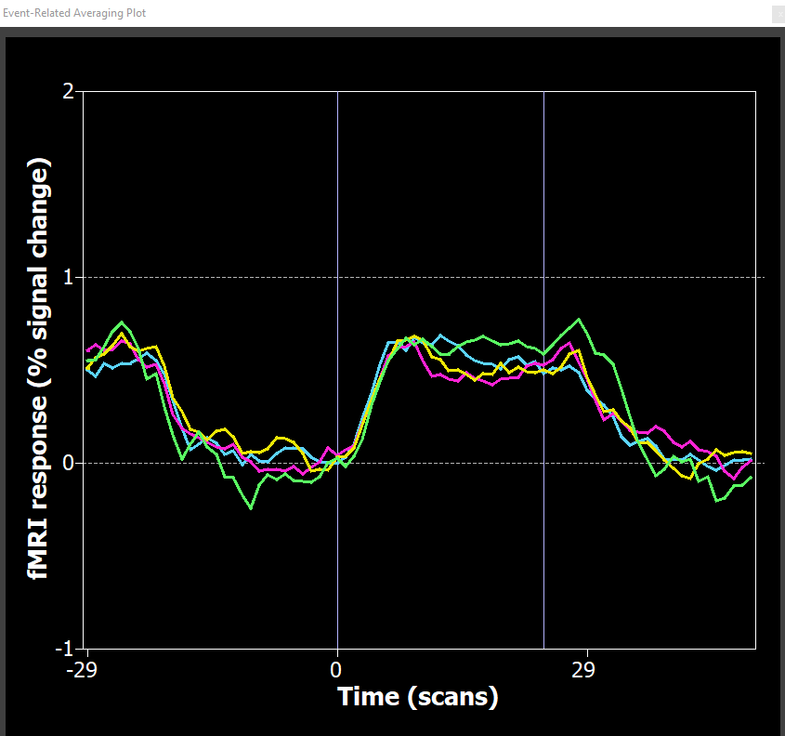
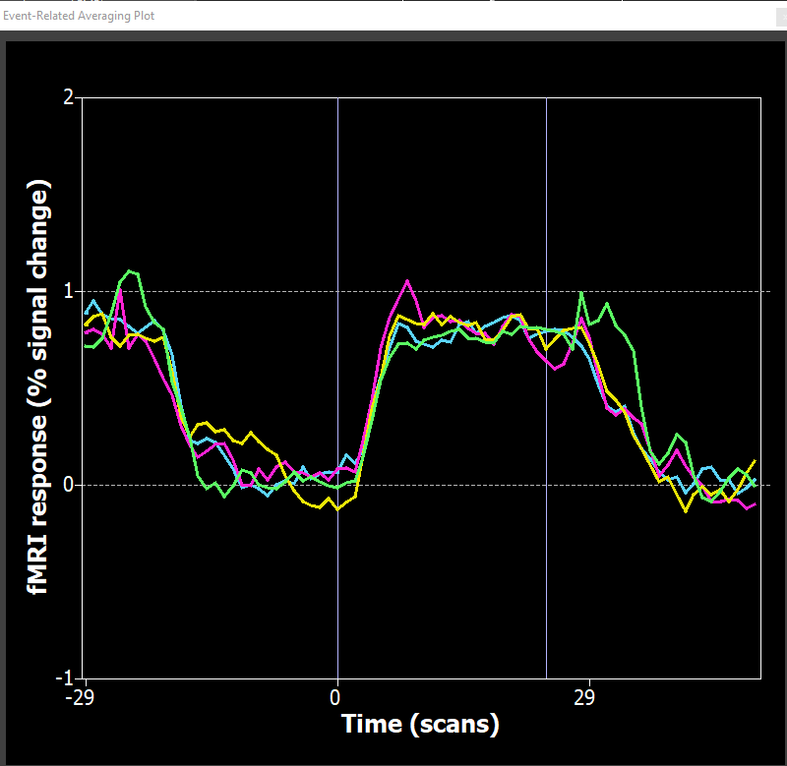
Single Sub All Runs ROI ERAs – FFA
Sub 3
Sub 4

Slide 10
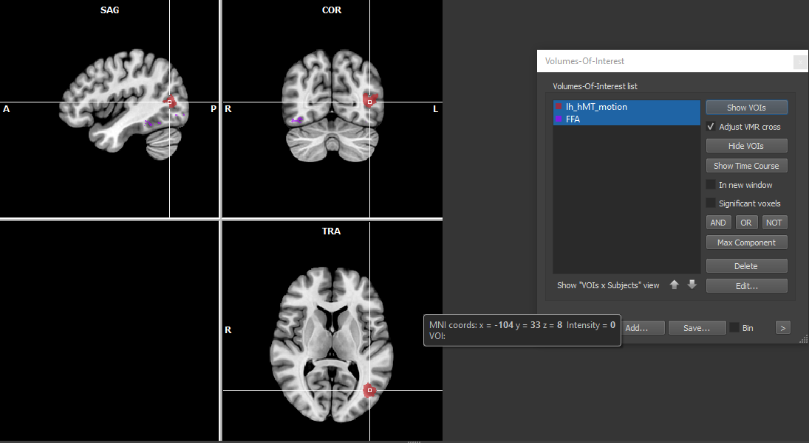
ROI- Rosenke MT and FFA

Slide 11
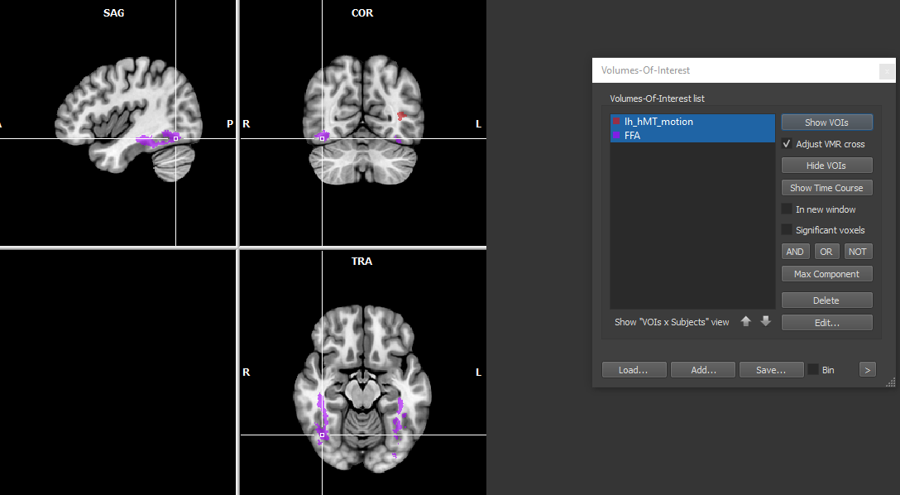
ROI- Rosenke FFA

Slide 12
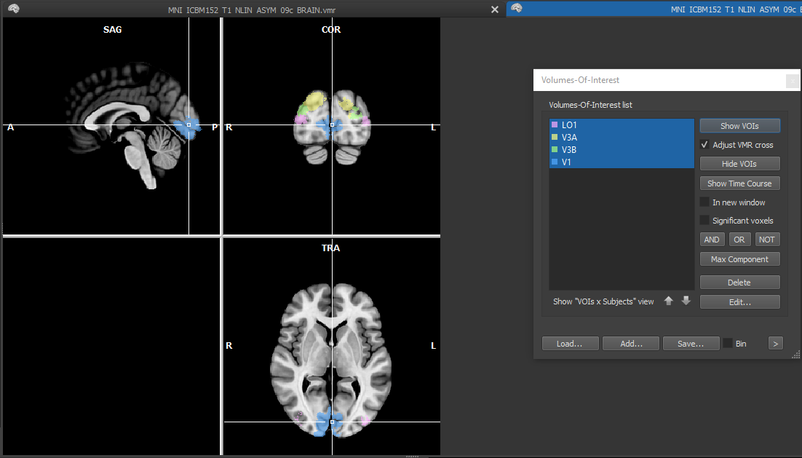
ROI- Kastner V1 V3A V3B and LO1

Slide 13
Multi-echo pilot data: Depth loc
n = 4
2 subjects with 1 run and 2 with 2 runs for 6 runs total

Slide 14
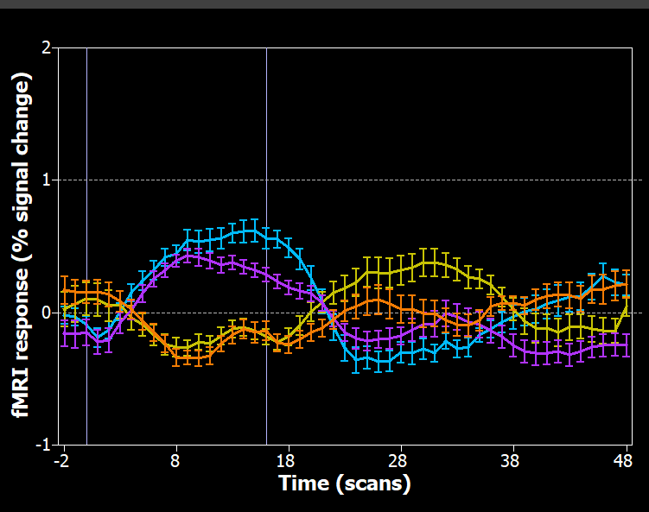

ERA – V3a

Slide 15
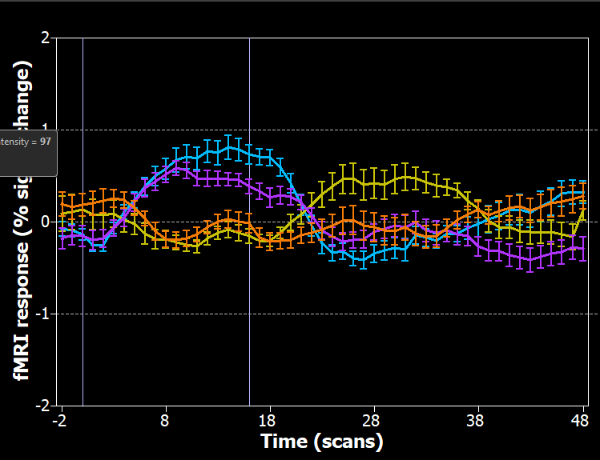
ERA – V3b

Slide 16
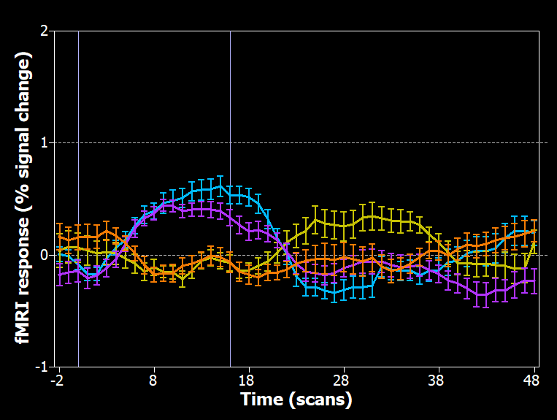
ERA – LO1

Slide 17
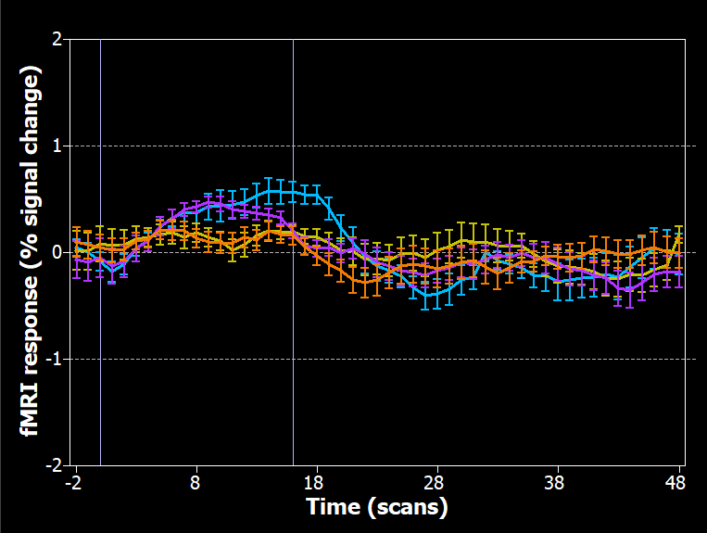
ERA – V1

Slide 18
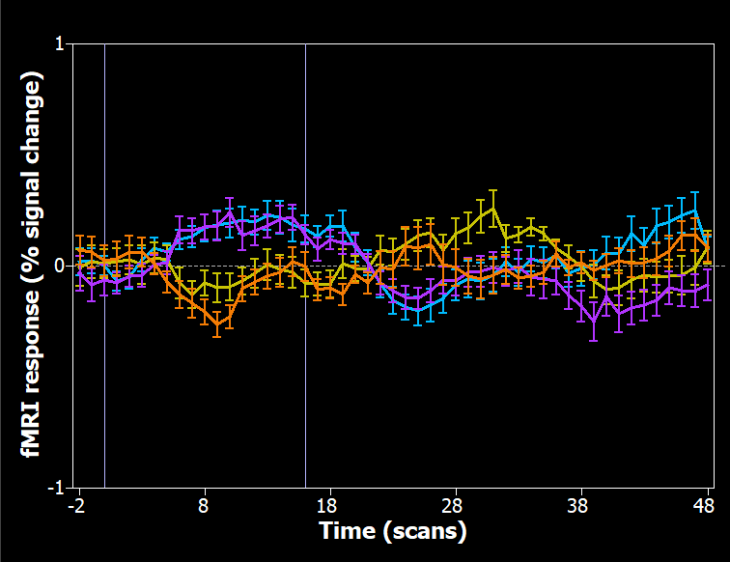
ERA – hMT

Slide 19
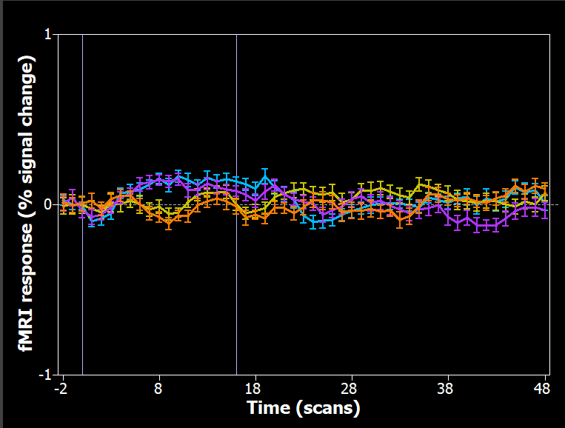
ERA – FFA

Slide 20
Middle Echos Faces
N = 4

Slide 21


Slide 22
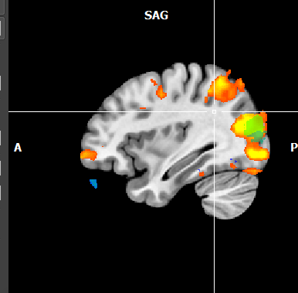
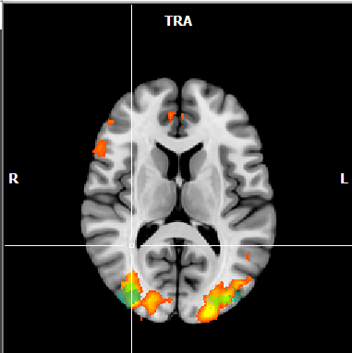
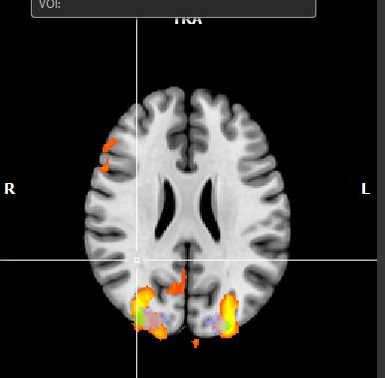
3D > 2D (n=4) FFX, no separate sub predictors, min 4.14 and max 8, no correction for serial correlation
Green = V3b
Turqoise = LO1
Lilac = V3a

Slide 23
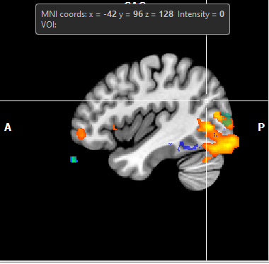
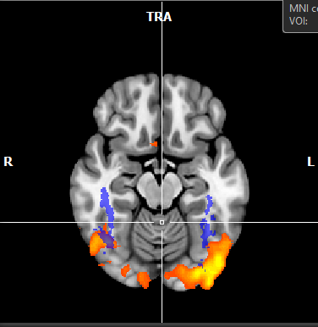
3D > 2D (n=4) FFX, no separate sub predictors, min 4.14 and max 8, no correction for serial correlation
Dark Green = hMT
Dark blue = FFA

Slide 24
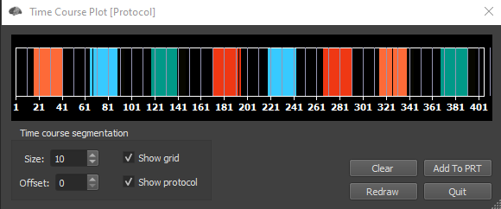
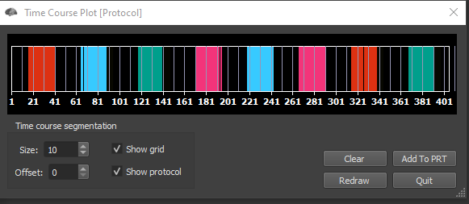
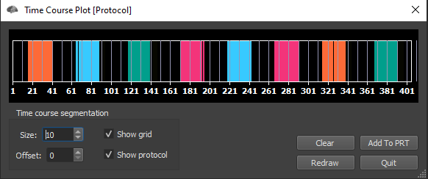
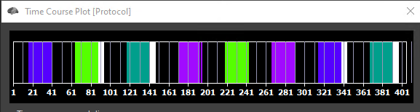
Condition Colours
1 3
2 4

